Slide 1
Class 1: Introduction
ECN 100B – Intermediate Microeconomics
Spring 2025
Prof. Muehlegger

Slide 2
Announcements
Sections will begin this week.
Office hours will start this week as well. The dates and times are posted as a Canvas discussion item.
You can also find the syllabus on Canvas.

Slide 3
Class Outline
Introduction and a few course details
Review of Profit Maximization and Perfect Competition
Questions

Slide 4
I. Introduction and course details

Slide 5
Introduction
My contact information:
Office: 1120 SS&H
Office Hours: Thursday, 11 – 1pm, in person
Email: emuehlegger@ucdavis.edu
Twitter: @erichmuehlegger
My Other Day Job: Economist studying environmental regulation / energy policy.

Slide 6
Teaching Team
We have four great TAs who’ll be part of the teaching team for the course.
Francisco Pizzi
Jessica Lyu
Maria Pulido
Robert Reaser
You can find the office hour schedule on Canvas.
You should feel free to attend any TA office hours.

Slide 7
Course resources
Lectures are the primary source of material for the course and all exams.
I provide handouts for lectures. I post them prior to class so you can take notes on them if you’d like. You can find them in Canvas → Files → Lecture Slides.
Recommended Textbook
Microeconomics: Theory and Applications with Calculus, by Jeffrey M. Perloff
Available through Open Access, any edition is fine.
You can find it under “Bookshelf” on Canvas

Slide 8
Classroom engagement and clickers
This course will use “in-class” polling.
It helps keep you engaged in the material
It lets you know whether or not you understand the material
It give me real-time feedback on whether I’ve presented the material clearly
It facilitates class discussion
Clicker questions will not be graded, nor will participation.
We will use iClicker which is free for UC Davis students.
9 – 10:20 (100B – A): https://join.iclicker.com/HTCC
1:40 – 3:00 (100B – B): https://join.iclicker.com/MZWB

Slide 9
Canvas
I will disseminate material for the course through Canvas
This includes:
Lecture Handouts
Problem Sets and Solutions
Questions to previous midterm and final
Check Canvas often!
Set your preferences to receive announcements by email!

Slide 10
Course Grading (details in syllabus)
Final Exam (35%)
100B – A: June 10th @ 8am.
100B – B: June 9th @ 8am.
Midterm Exam (25%)
In class, Tuesday, May 6th.
Problem sets (20%)
Weekly Quizzes (20%)

Slide 11
II. Profit maximization (Perloff 8.2)

Slide 12
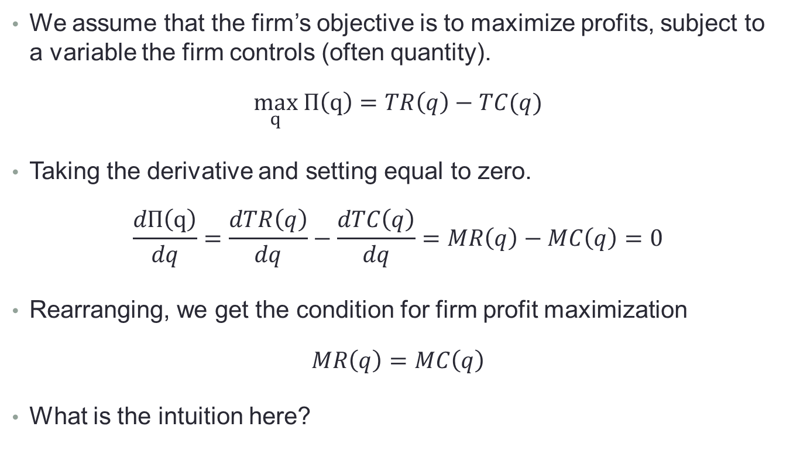
Firms seek to maximize profits
We assume that the firm’s objective is to maximize profits, subject to a variable the firm controls (often quantity).
$$\max_{q} Π\left(q\right)=TR\left(q\right)−TC(q)$$
Taking the derivative and setting equal to zero.
$$\frac{dΠ\left(q\right)}{dq}=\frac{dTR\left(q\right)}{dq}−\frac{dTC\left(q\right)}{dq}=MR\left(q\right)−MC\left(q\right)=0$$
Rearranging, we get the condition for firm profit maximization
$$MR\left(q\right)=MC\left(q\right)$$
What is the intuition here?

Slide 13
Graphical depiction of profit maximization
Profits are maximized at q*, the point where MR = MC
q*
MR>MC
MR<MC
Profit
Quantity

Slide 14
II. Perfect competition in the short run (Perloff 8.3)

Slide 15
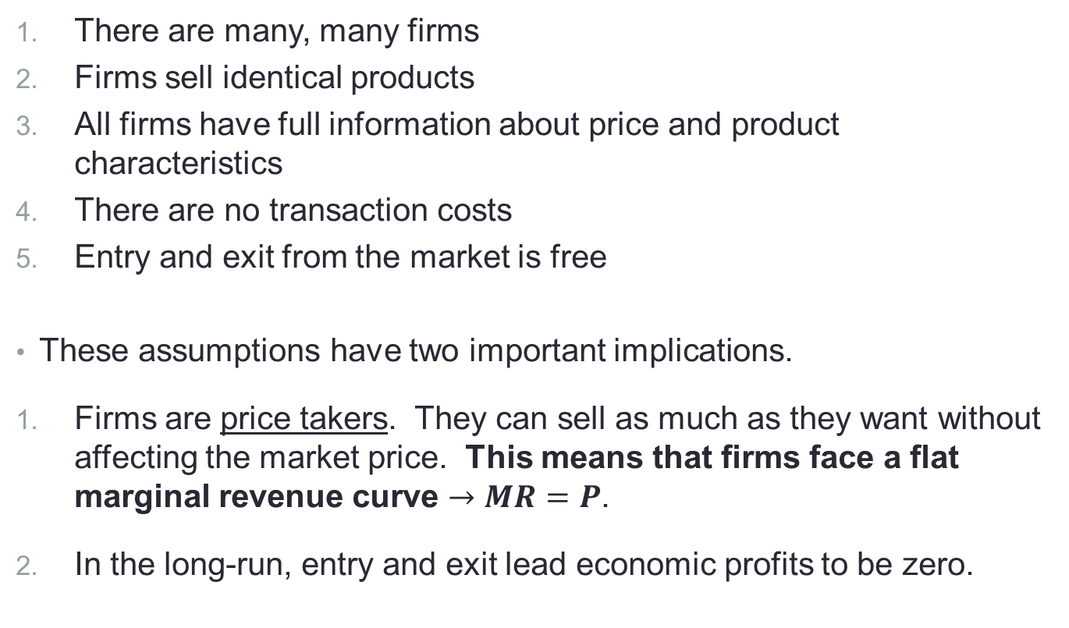
What are the assumptions of perfect competition?
There are many, many firms
Firms sell identical products
All firms have full information about price and product characteristics
There are no transaction costs
Entry and exit from the market is free
These assumptions have two important implications.
Firms are price takers. They can sell as much as they want without affecting the market price. This means that firms face a flat marginal revenue curve $→MR=P$.
In the long-run, entry and exit lead economic profits to be zero.

Slide 16
Short-run competitive equilibrium
The competitive equilibrium is the price and quantity where market supply equals market demand.
We can find the competitive equilibrium in three steps:
Calculate the firm supply curve, how much each firm will produce as a function of price.
Sum the firm supply curves horizontally to get the market supply curve, how much all firms will produce as a function of price
Equate market supply and market demand.

Slide 17
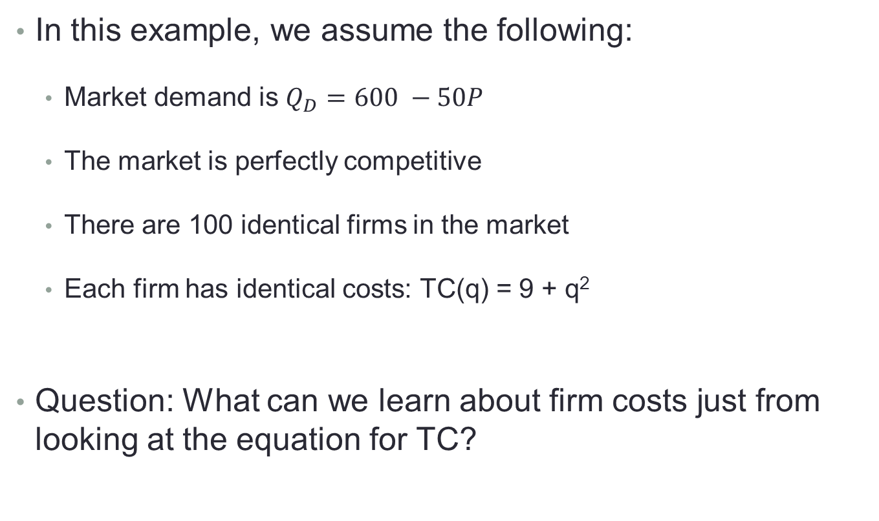
We’ll consider a specific example
In this example, we assume the following:
Market demand is $Q_{D}=600 −50P$
The market is perfectly competitive
There are 100 identical firms in the market
Each firm has identical costs: TC(q) = 9 + q²
Question: What can we learn about firm costs just from looking at the equation for TC?

Slide 18
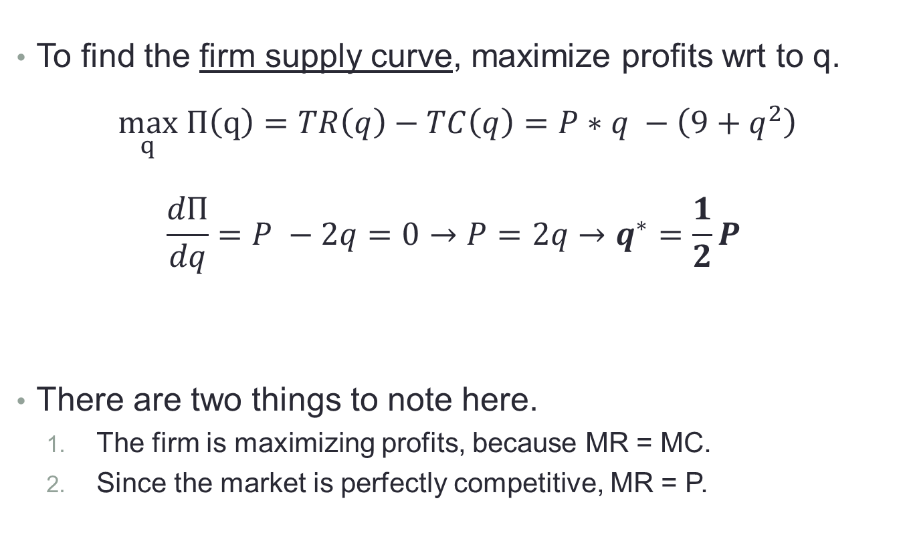
Step 1: What is the firm supply curve?
To find the firm supply curve, maximize profits wrt to q.
$$\max_{q} Π\left(q\right)=TR\left(q\right)−TC\left(q\right)=P∗q −\left(9+q^{2}\right)$$
$$\frac{dΠ}{dq}=P −2q=0→P=2q→q^{∗}=\frac{1}{2}P$$
There are two things to note here.
The firm is maximizing profits, because MR = MC.
Since the market is perfectly competitive, MR = P.
MR
MC
Firm Inverse
Supply Curve
Firm Supply Curve

Slide 19

Profit maximization graphically
Using an example with P = 10, and our firm supply curve, $q^{∗}=\frac{1}{2}P$
$$Π\left(q\right)=TR\left(q\right)−TC\left(q\right)=10∗q −\left(9+q^{2}\right)$$
MC = 2q
Profit
14
MR>MC
q*
MR<MC
P
16
10
MR = P
12
6
3
5
7
q
3
5
7
q

Slide 20
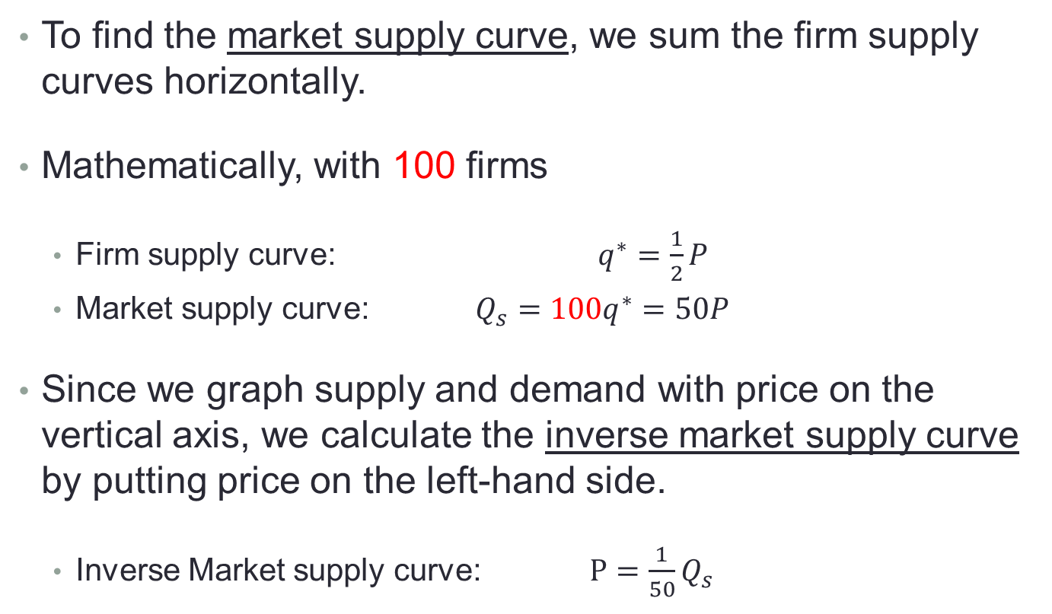
Step 2: What is the market supply curve?
To find the market supply curve, we sum the firm supply curves horizontally.
Mathematically, with 100 firms
Firm supply curve: $q^{∗}=\frac{1}{2}P$
Market supply curve: ${Q_{s}=100q}^{∗}=50P$
Since we graph supply and demand with price on the vertical axis, we calculate the inverse market supply curve by putting price on the left-hand side.
Inverse Market supply curve: $P=\frac{1}{50}Q_{s}$

Slide 21



Step 2: What is the market supply curve?
Graphically, we horizontally sum the 100 firm supply curves to get the market supply curve.
Individual Firm
Overall Market
P
P
S
$$q_{1}$$
$$q_{1}+q_{2}$$
$$q_{1}+q_{2}+q_{3}$$
10
5
10
15
q
500
Q

Slide 22
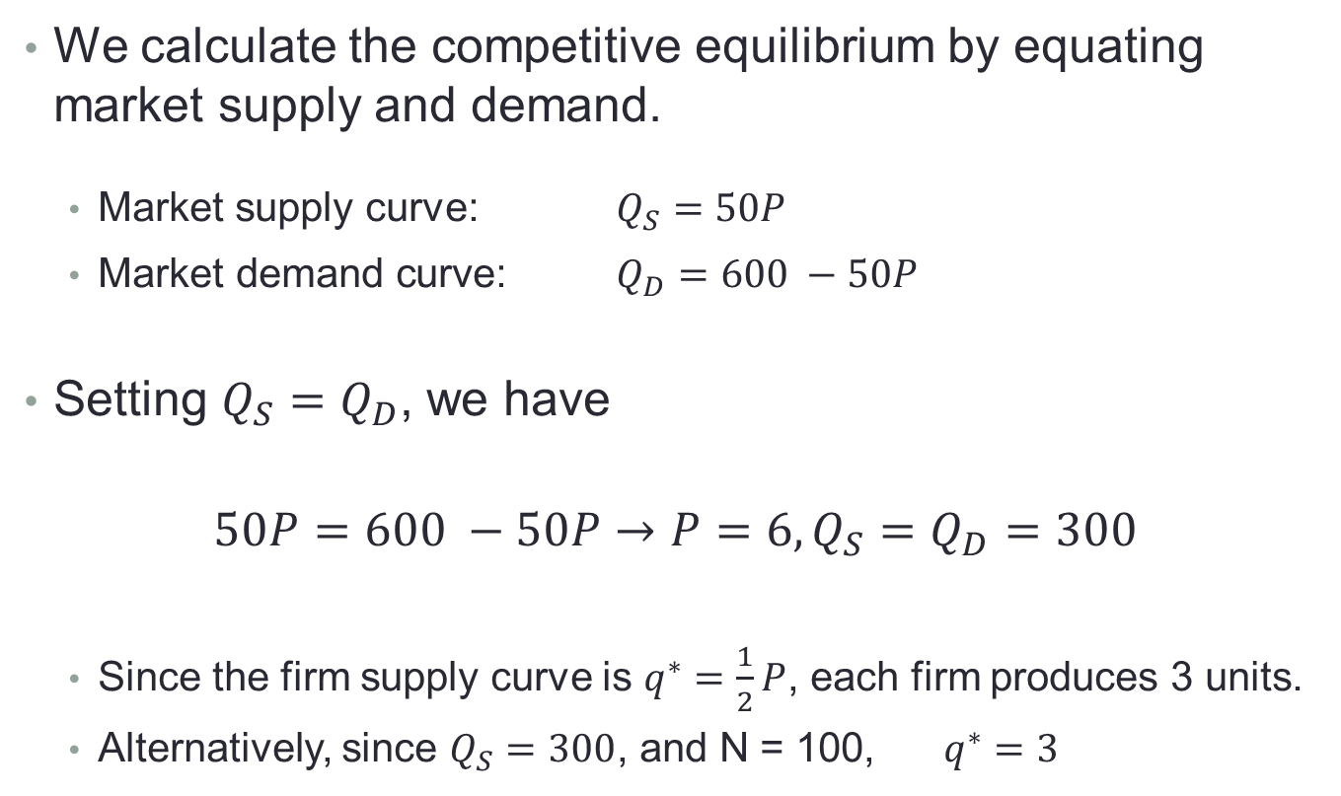
Step 3: Find the competitive equilibrium
We calculate the competitive equilibrium by equating market supply and demand.
Market supply curve: $Q_{S}=50P$
$\text{Market} \text{demand} \text{curve}\text{:}$ $Q_{D}=600 −50P$
Setting $Q_{S}=Q_{D}$, we have
$$50P=600 −50P→P=6, Q_{S}=Q_{D}=300$$
Since the firm supply curve is $q^{∗}=\frac{1}{2}P$, each firm produces 3 units.
Alternatively, since $Q_{S}=300$, and N = 100, $q^{∗}=3$

Slide 23




Graphical depiction of the competitive equilibrium in our example
Since we graph with price on the vertical axis, we always want to have price on the left-hand side.
Market supply curve:
$$Q_{S}=50P$$
Individual Firm
Market
Inverse supply curve:
$$P=\frac{1}{50}Q_{s}$$
P
P
MC = 2q
Market demand curve:
$$Q_{D}=600 −50P$$
P=6
P=6
MR
Inverse demand curve:
$$P=12 −\frac{1}{50}Q_{D}$$
q*=3
q
Q=300
Q

Slide 24
III. Perfect competition in the long-run (Perloff 8.4)

Slide 25

In our example, do the firms earn economic profits?
In this example, the competitive equilibrium is $P=6, q=3$
$Π =TR−TC$
$$=P∗q −\left(9+q^{2}\right)=18−\left(9+3^{2}\right)=0$$
Individual Firm
Market
P
P
MC
AC = TC/q
S
P=6
MR
D
q*=3
q
Q=300
Q

Slide 26
Economic profits
In the example above, firms earn zero economic profits.
What does this mean?
Economic profits include the opportunity cost of capital.
If a firm earns zero economic profits, their return in this industry is as good as the return they could receive from an equally risky industry.
Consequently, firms do not want to enter nor exit the market.

Slide 27
Can firms ever earn economic profits?
In the short-run, firms can change quantities, but can’t enter or exit the market.
Thus, they can make short-run economic profits or losses.
But, in a competitive market in the long-run, firms can freely entry and exit the market.
If firms are earning economic profits in the short-run, entry will shift the market supply outwards
If firms are bearing economic losses in the short-run, exit will shift the market supply curve inwards
Entry and exit will happen until economic profits are zero.

Slide 28
Example with an inward demand shock
Consider restaurants at the start of COVID – let’s assume that they earn zero economic profit initially.
COVID shifts demand for restaurants inward → Price falls
As equilibrium price falls, firms bear economic loses in short-run.
Firms exit the market, supply shifts inward until profit is zero again.
Individual Firm
Market
S’
P
P
MC
AC
S
3
MR
P
2
1
D
D’
q*
q*
q
Q
Q

Slide 29
IV. Perfect competition and welfare

Slide 30
Social Welfare and Perfect Competition
Consumer surplus is the amount, in dollars, that consumers benefit from the existence of the market.
Graphically, CS is the area below the inverse demand curve, but above price.
Producer surplus is the amount, in dollars, that producers benefit from the existence of the market.
Graphically, PS is the area above the inverse supply curve, but below price.

Slide 31
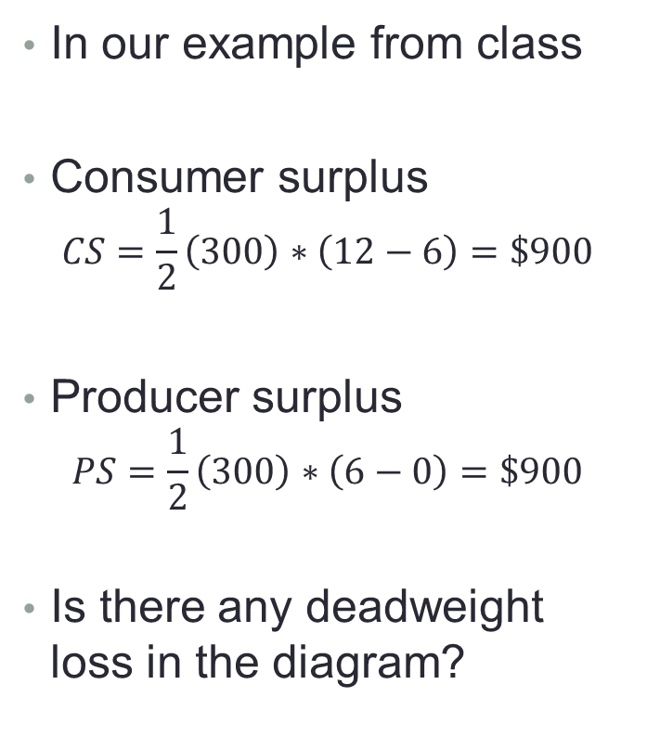
Consumer and Producer Surplus
In our example from class
Consumer surplus
$$CS=\frac{1}{2}\left(300\right)∗\left(12−6\right)=\$900$$
Producer surplus
$$PS=\frac{1}{2}\left(300\right)∗\left(6−0\right)=\$900$$
Is there any deadweight loss in the diagram?
P
Market
12
CS
S
6
PS
D
0
Q=300
Q

Slide 32
Market Failures and Welfare
The perfectly competitive market maximizes welfare.
There is no deadweight loss and in the long-run, firms produce at the minimum of their average cost curves.
But, there are three common sources of market failure, situations in which an unregulated market may not maximize welfare.
Firms are not price-takers (e.g., monopoly)
Actions create benefits or impose costs on others (e.g., air pollution)
Some parties have information that others don’t (e.g., used car reliability)
This is the where economics brings real value to policy and is an outline for this course!

Slide 33
Major takeaways
Perfectly competitive firms set MR = MC to maximize profits.
Price-taking means that MR = P. A firm can sell as much as it wants at price P without affecting the market price.
Horizontally adding the firm supply curves together gives the market supply curve.
In the short-run, firms in a perfectly competitive market can earn economic profits or bear economic losses. But, in the long-run, free entry and exit will drive economic profits to zero.
The perfectly competitive market maximizes welfare and doesn’t create deadweight loss.
But, if firms are not price takers, actions create externalities, or information is asymmetric, deadweight loss might exist in the unregulated market.

Slide 34
Action Items
Review the syllabus on Canvas
Register for the course on iClicker Student
Handouts are available before lectures. You can find them on Canvas.
The textbook is available under Bookshelf on Canvas. Next class we will cover Perloff 11.1, 11.2.

